Slide 1
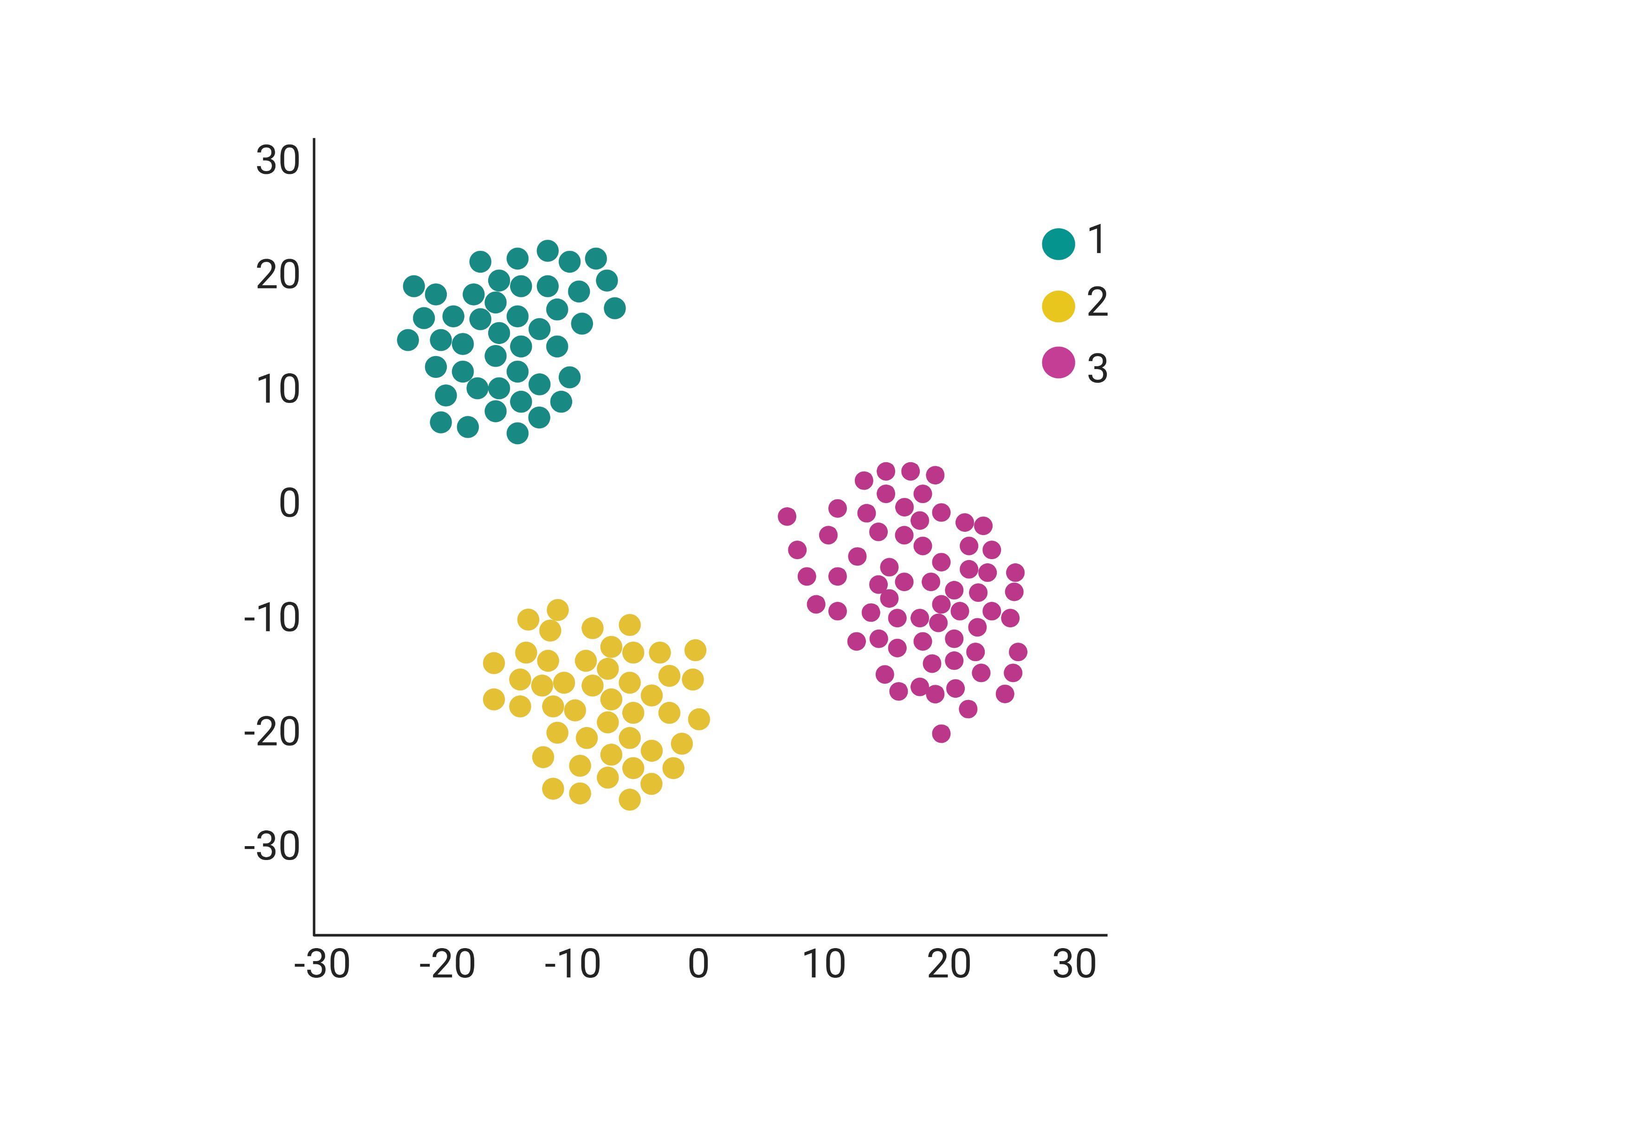
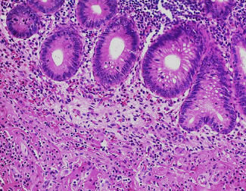
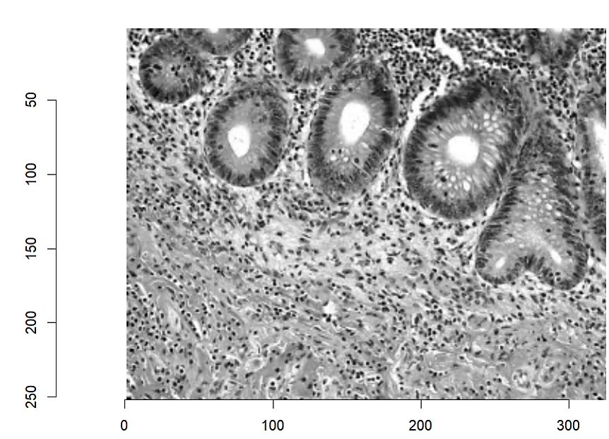
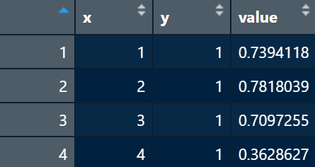
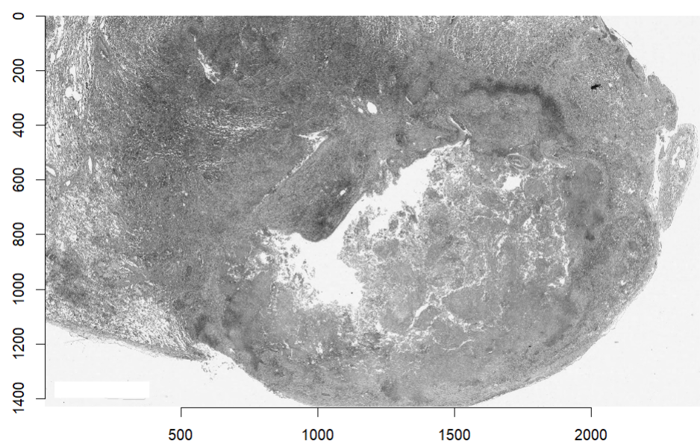
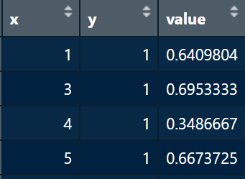
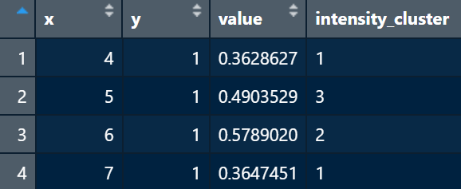
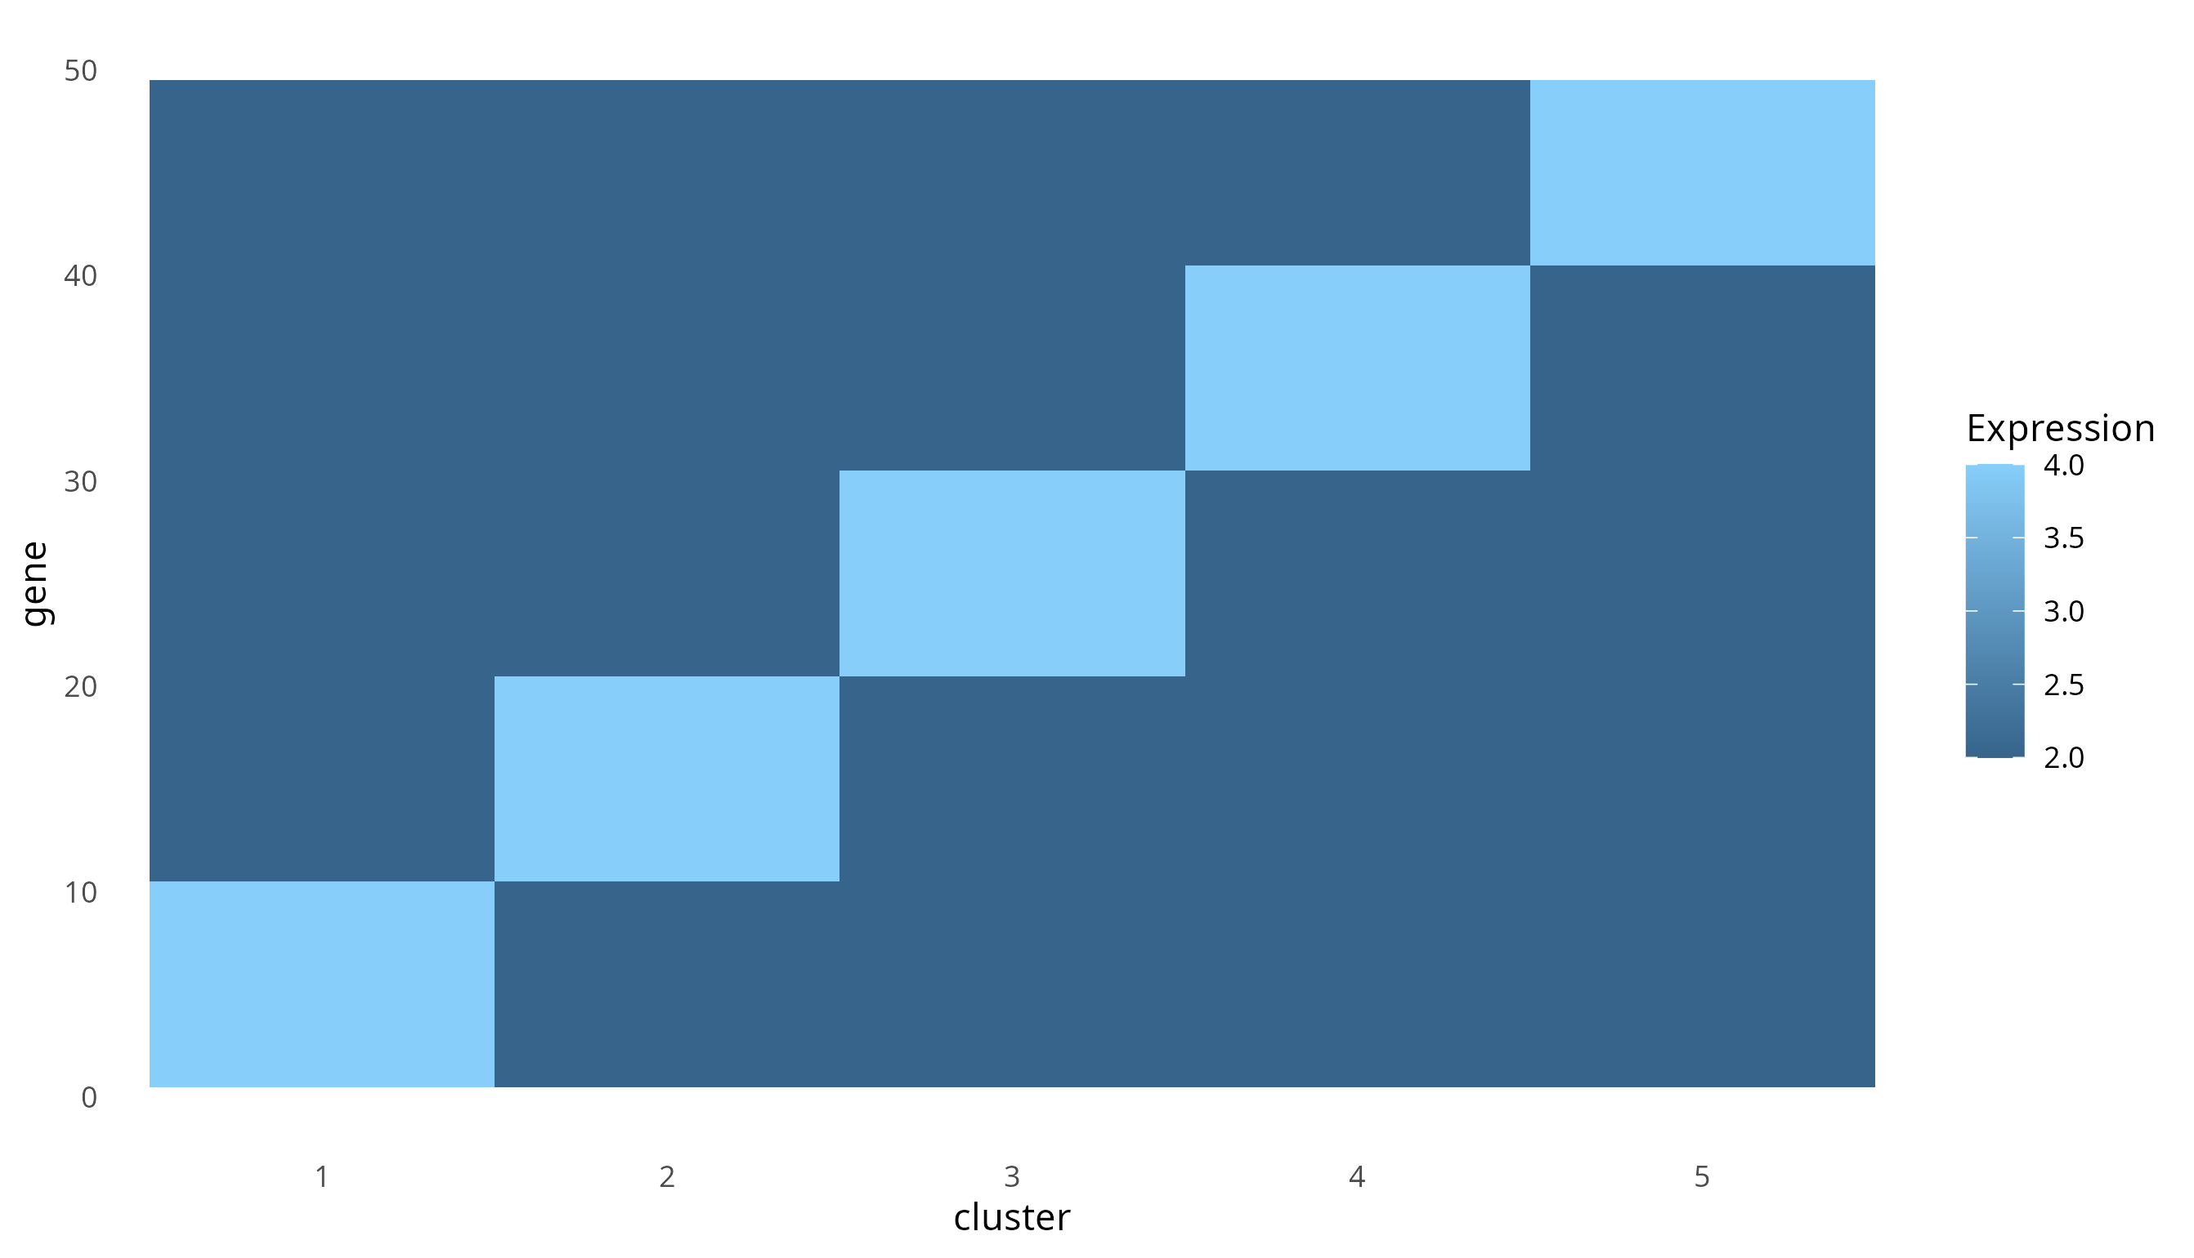
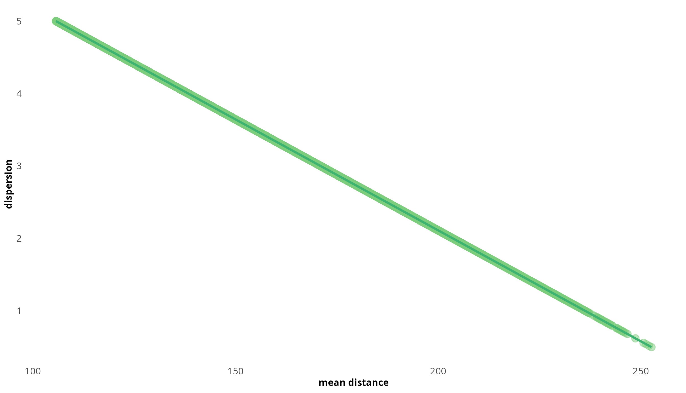
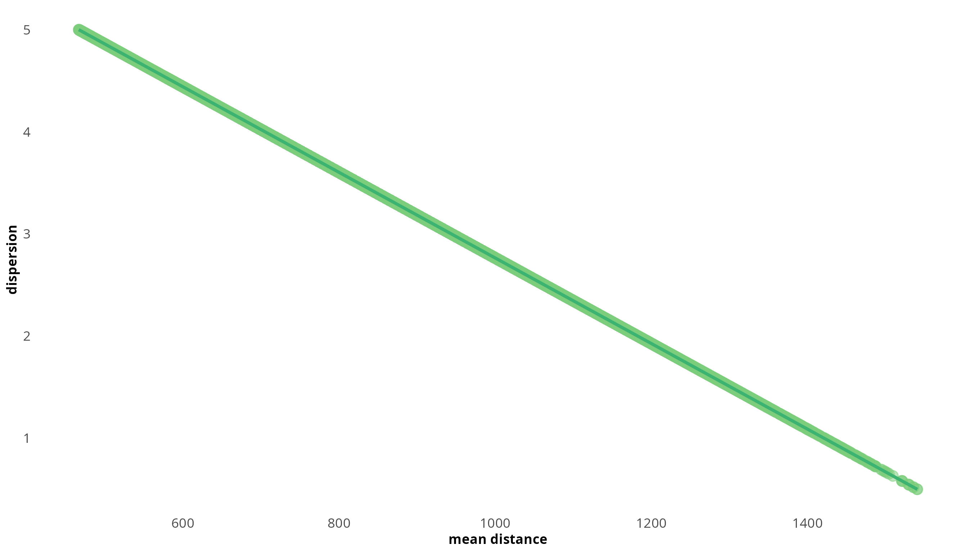
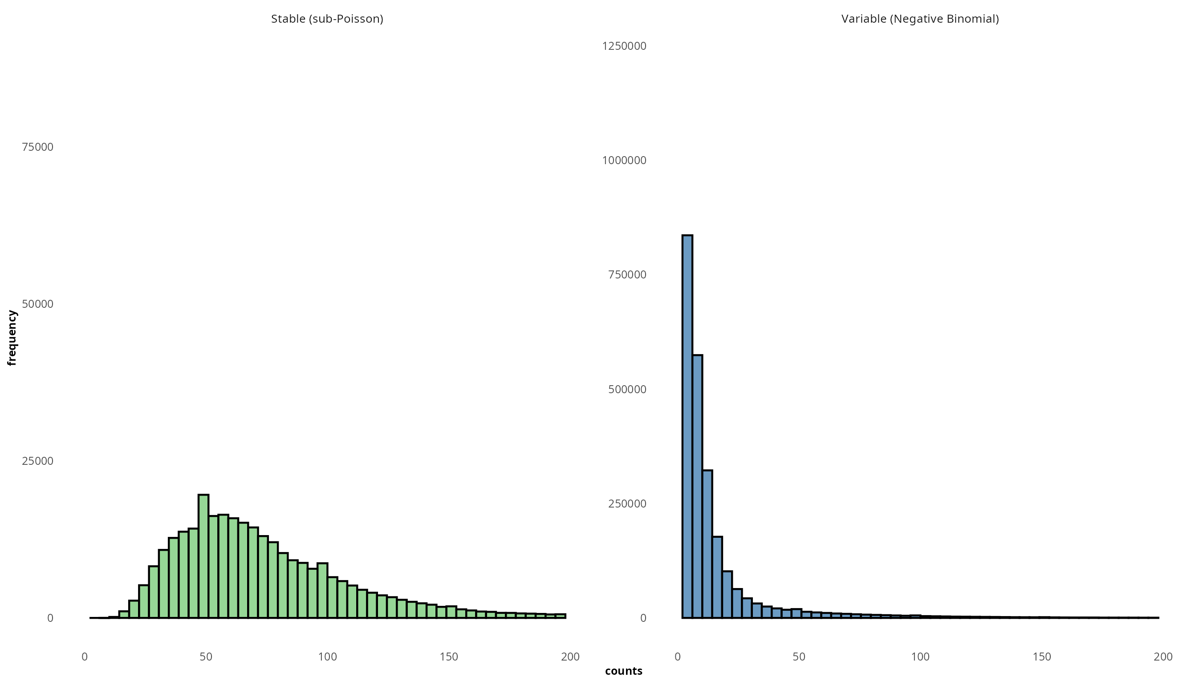
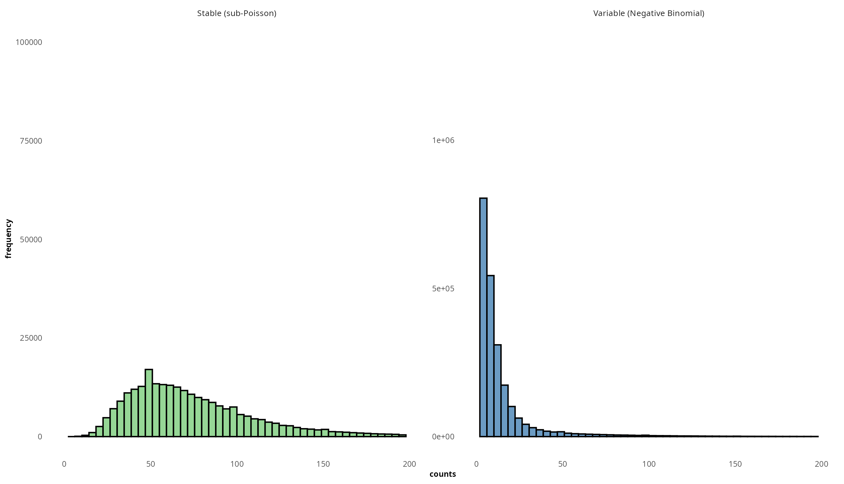
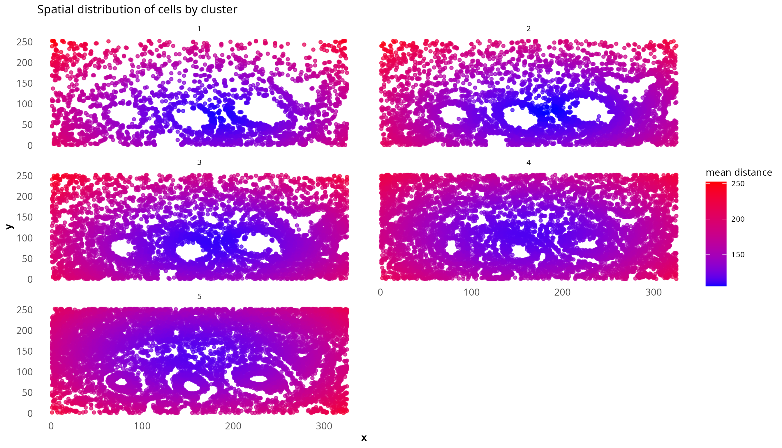
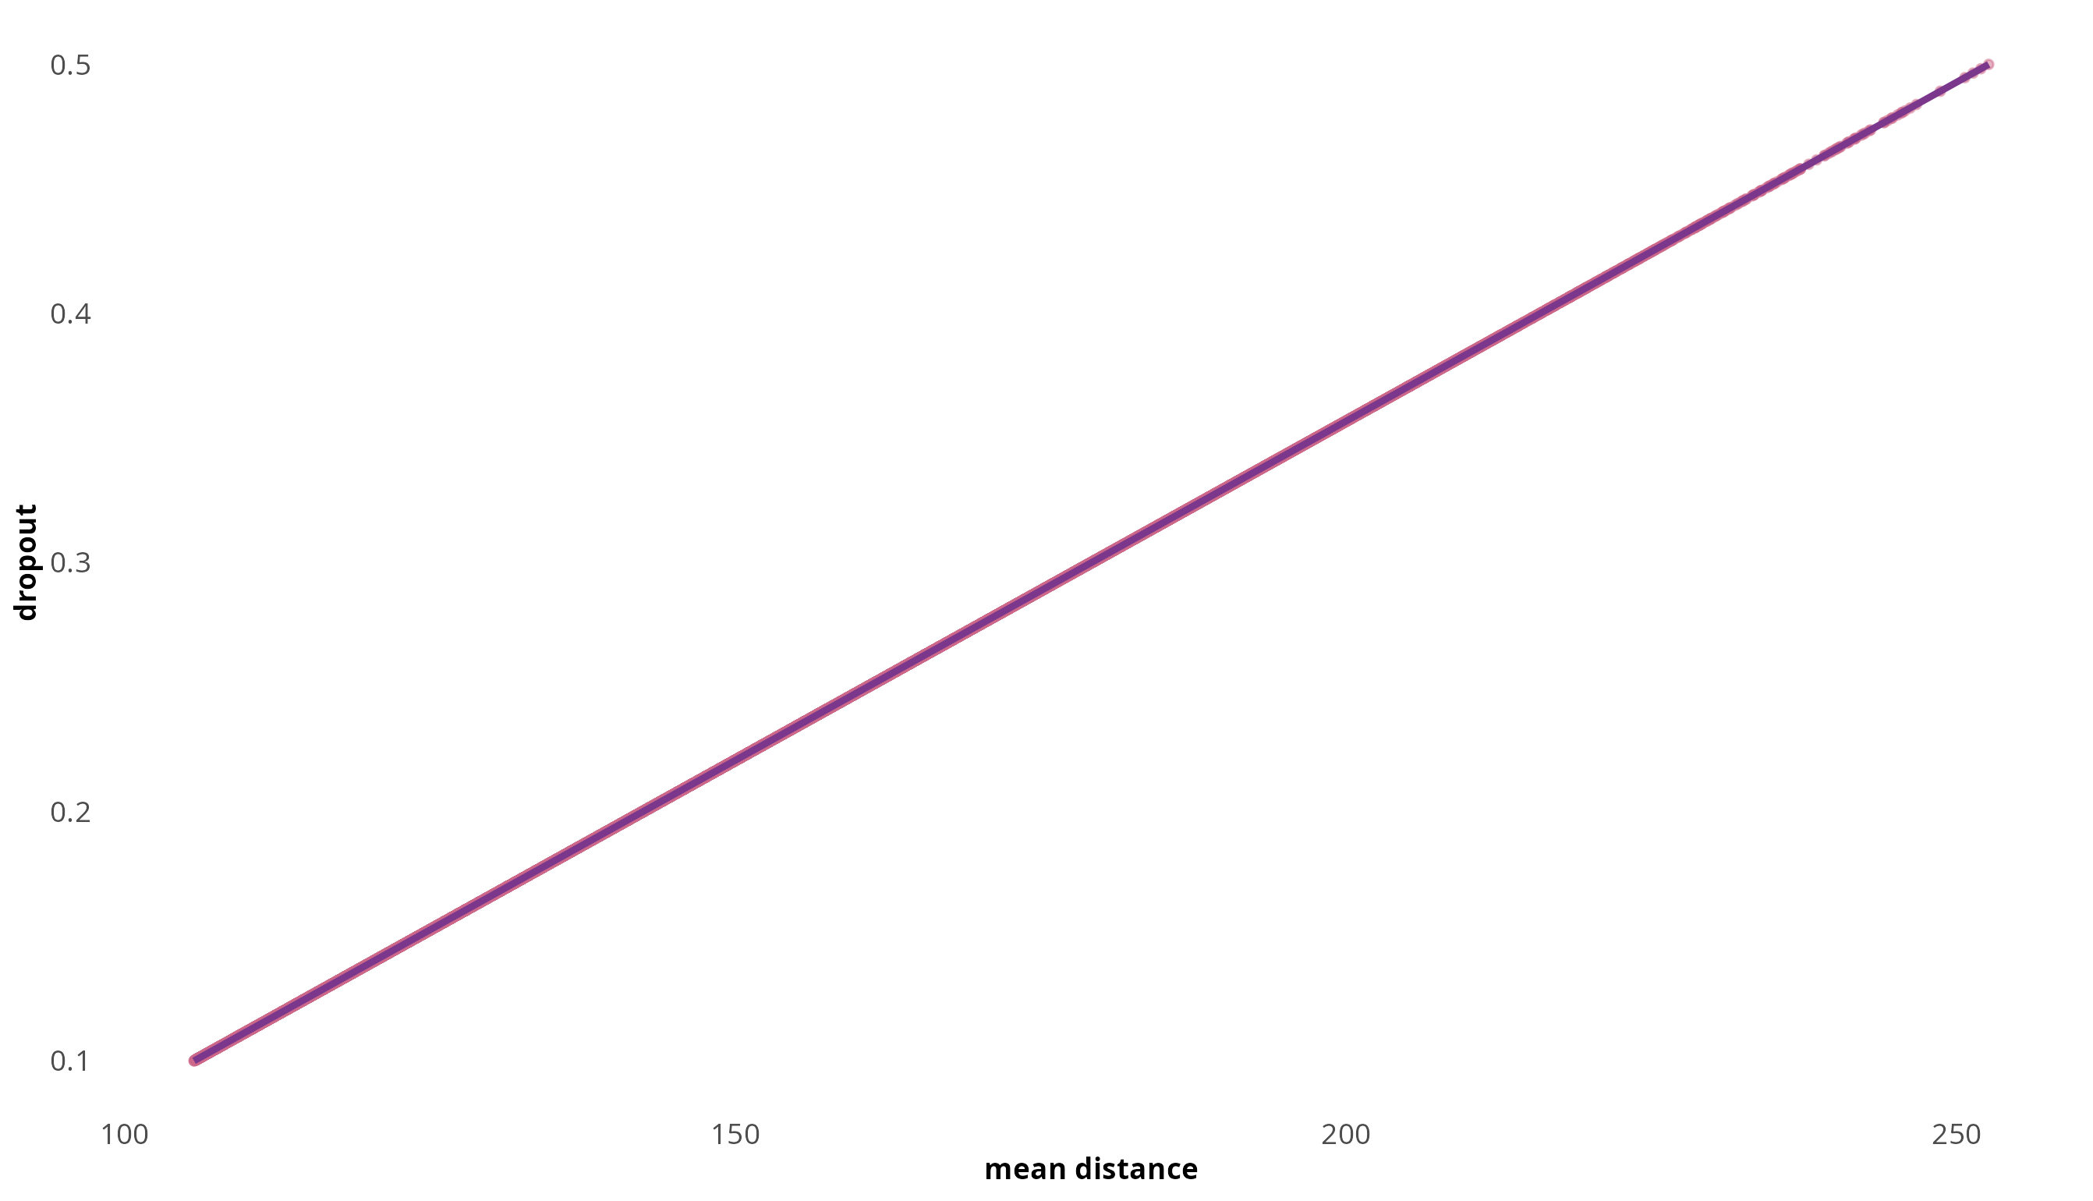
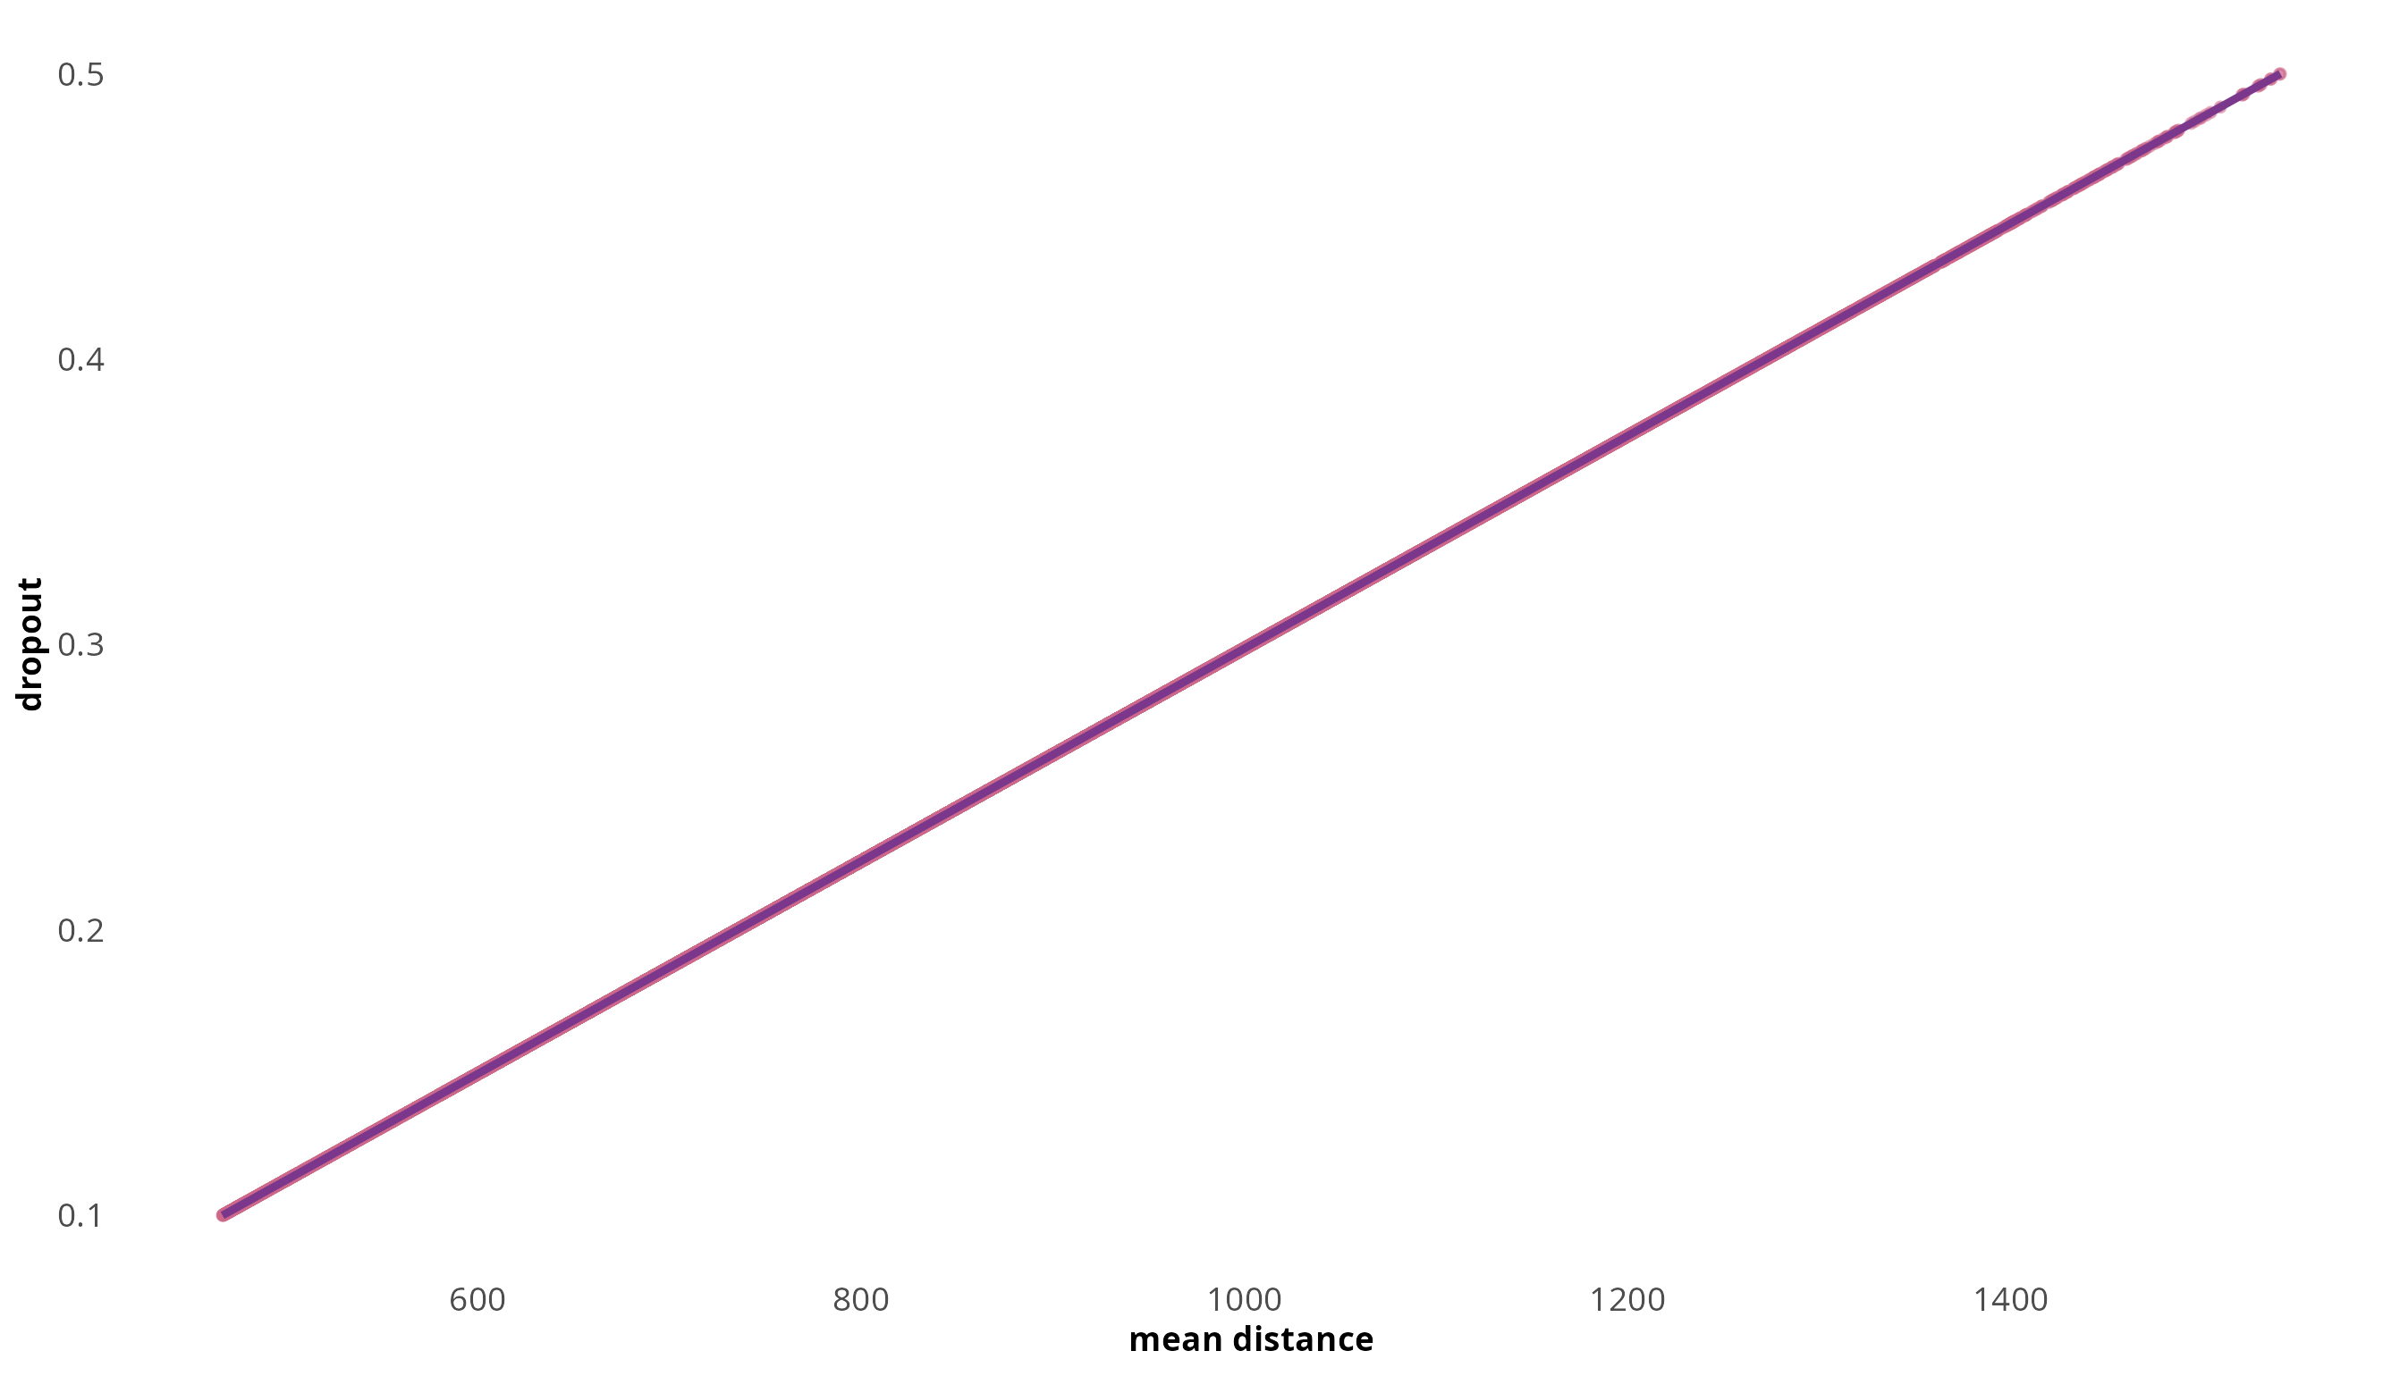
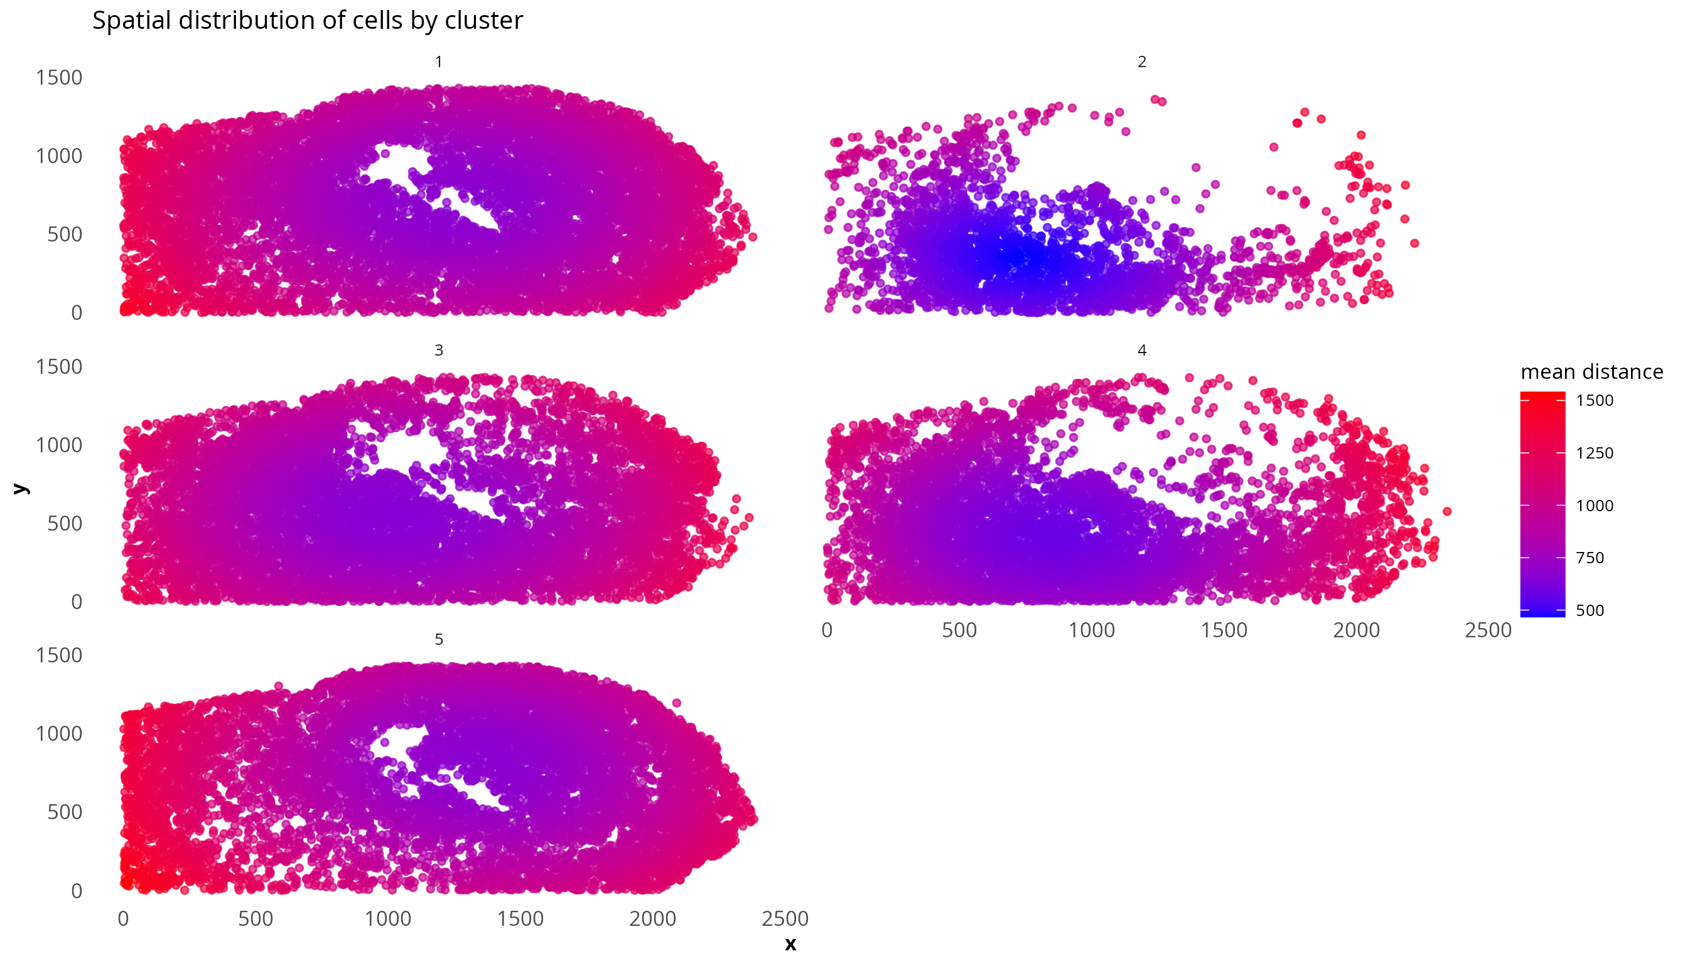
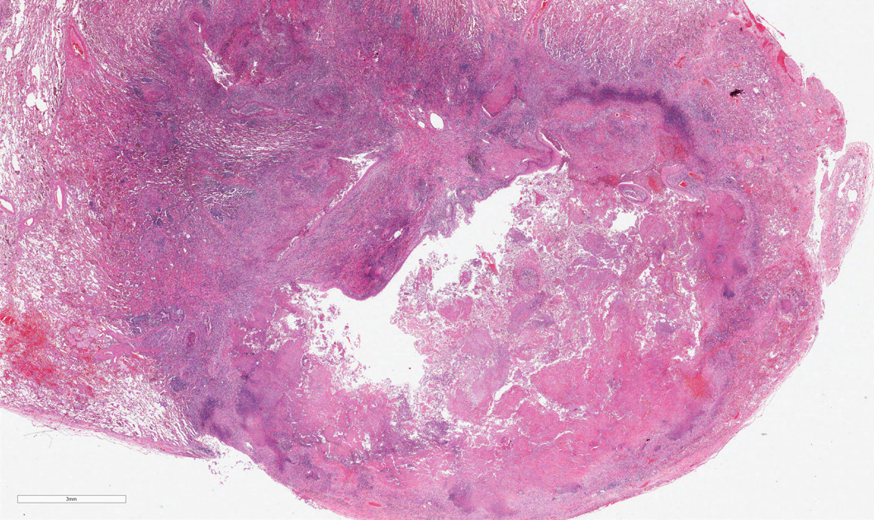
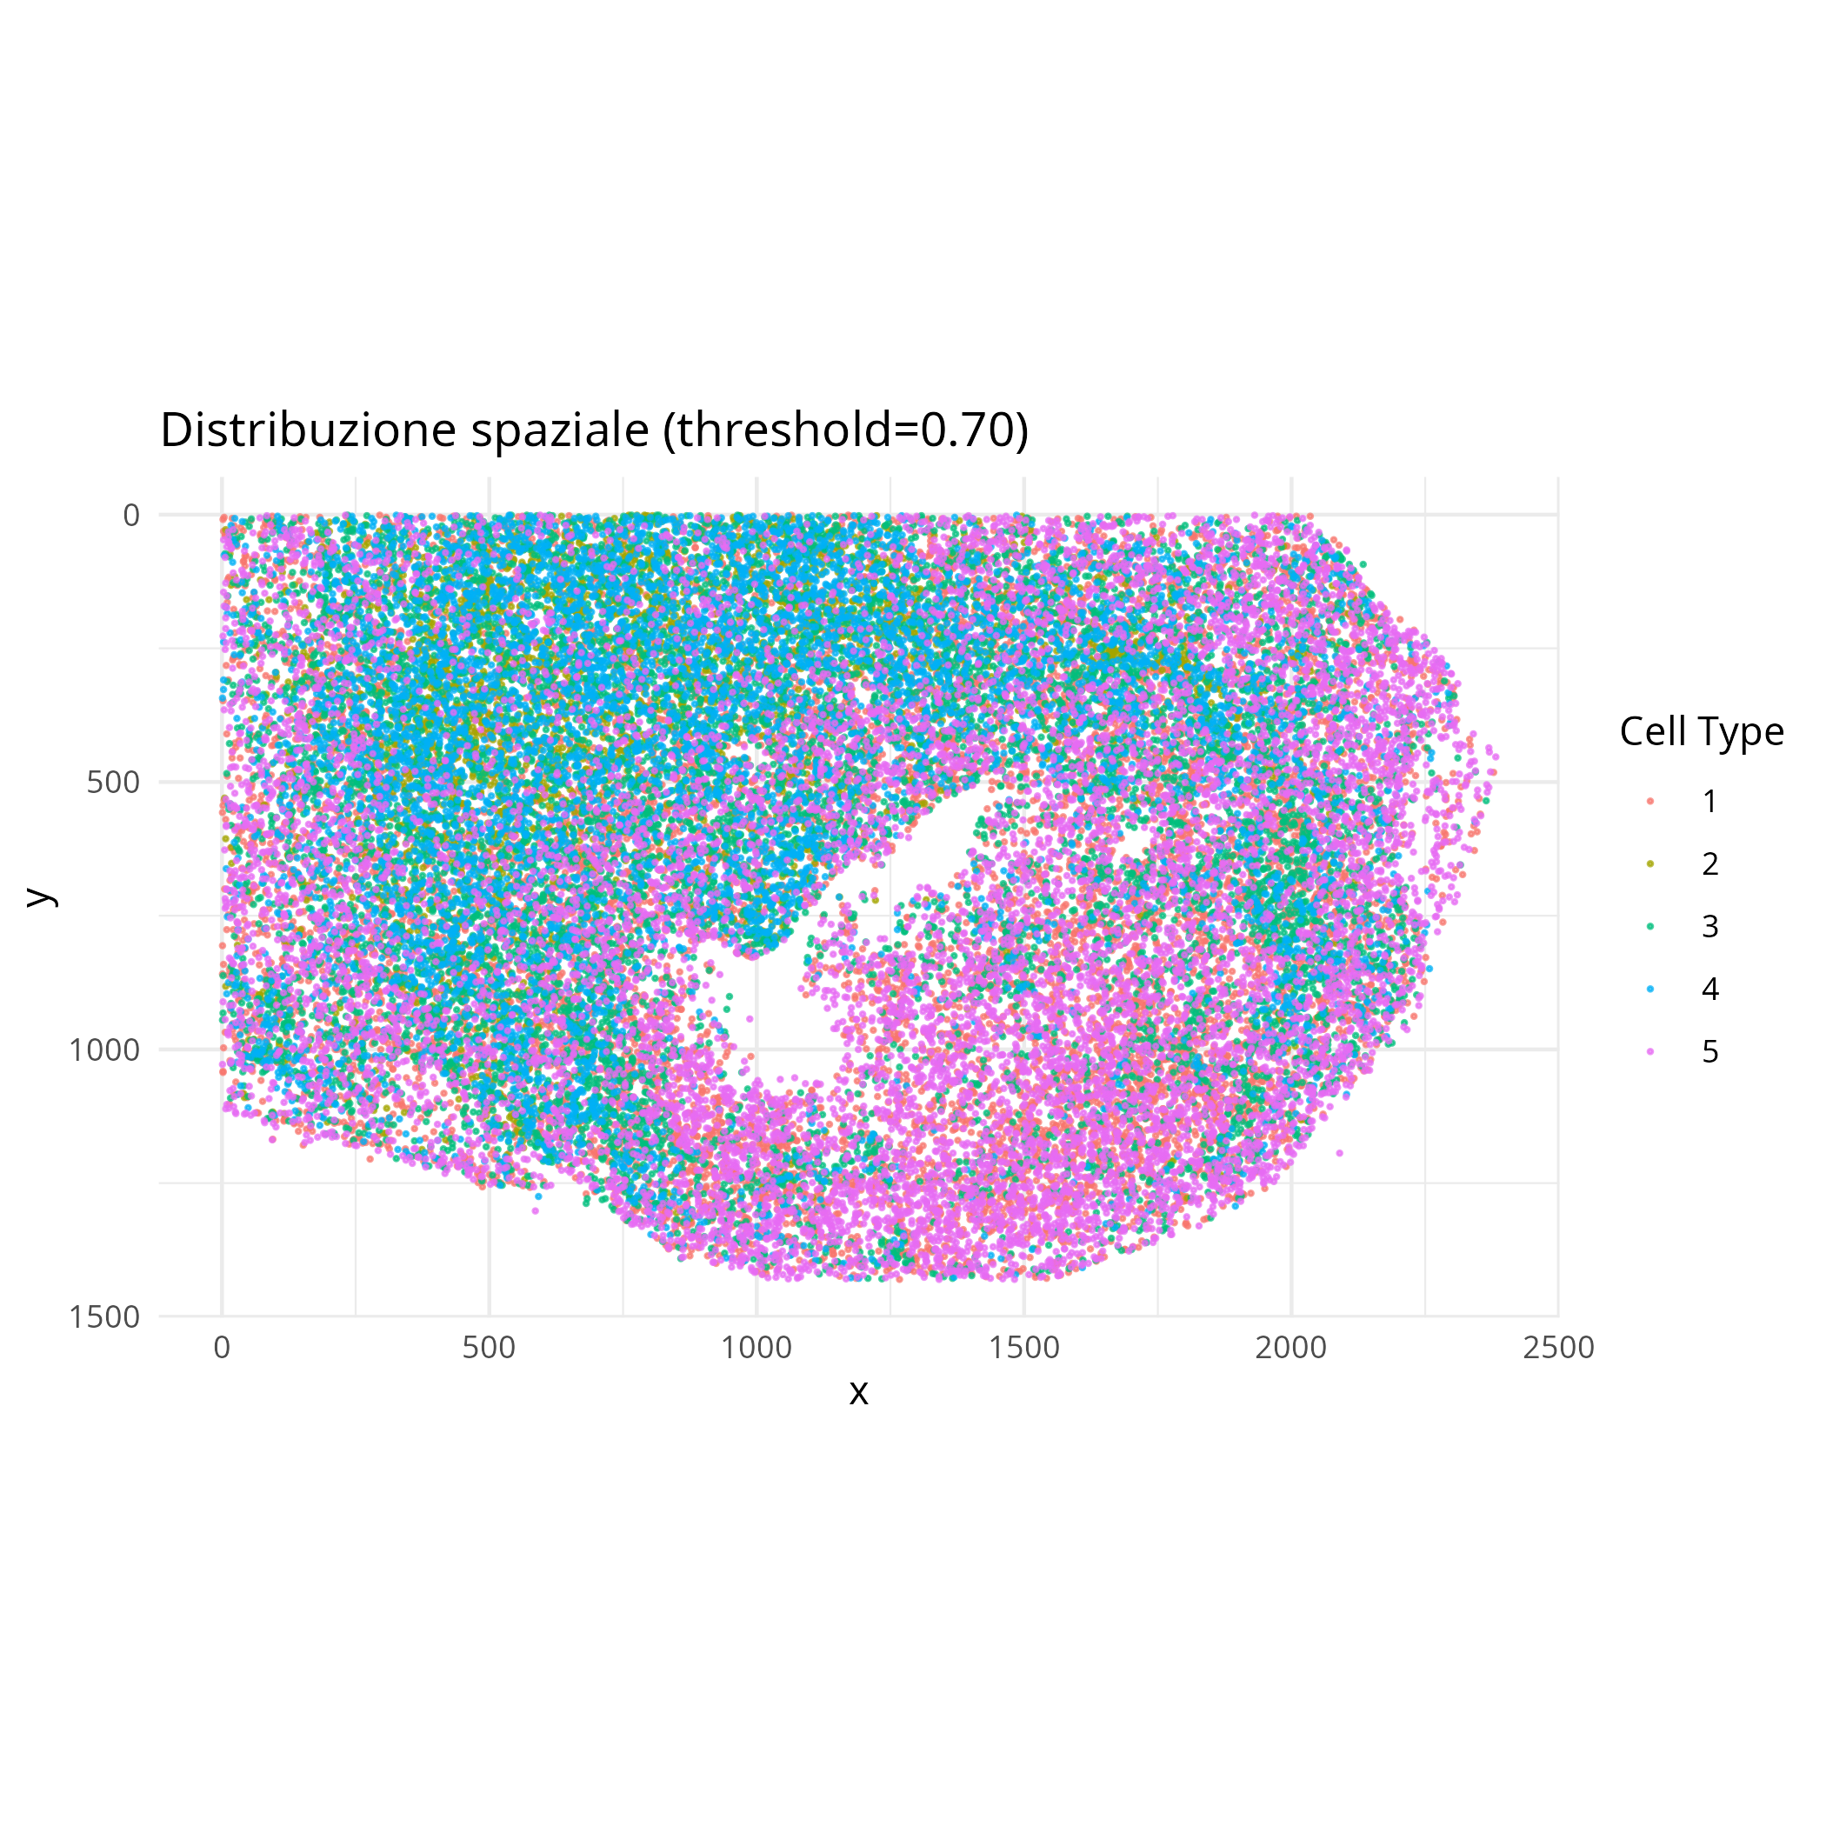






Simulation framework for spatial single-cell RNA-sequencing data
Daniele Sabbatini^{1,2}, Pierangela Palmerini^{1,3}, Giorgia Stoppa¹, Dolores Cattelan¹, Annibale Biggeri¹, Dario Gregori¹ and Luca Vedovelli¹
¹Department of Cardiac, Thoracic, Vascular Sciences and Public Health, University of Padua, Italy
²Department of Neurosciences, University of Padua, Italy
³Veneto Institute of Oncology-IRCCS, Padua, Italy
Introduction
Advances in single-cell spatial transcriptomics led to the development of simulation frameworks to overcome challenges associated with sample availability, quality, and the costs linked to real-data generation. However, most existing benchmarks lack a known ground truth, which limits the ability to fully control simulation parameters. To overcome this limitation, we introduce a novel simulation benchmark that generates synthetic single-cell spatial datasets closely resembling biological scenarios, yet offering absolute control over every parameter. This approach not only closely reproduces the spatial patterns and intrinsic noise of tissues, but also allows researchers to systematically manipulate key factors, thus making it possible to adapt the simulation to any context.
Methods
1. Configurating parameters
2. Image processing and thresholding
3. Clustering and sampling
We have defined the following simulation parameters:
-numer of cells: 30000
-number of genes: 100
-number of clusters (cell types): 3 or 5
-pixel threshold: 0.7
a) loading the input image (H&E staining)
b) converting color images to grayscale
c) “squeezing" the image to remove redundant dimensions
d) generating data frame with spatial coordinates (x, y) and intensity values
e) thresholding to exclude high-intensity background pixels
Clustering: K-means++ algorithm is used to cluster pixels with similar intensity, mimicking distinct cell types in real biological data
Sampling:
a) calculate frequency of each cluster
b) determine how many cells to sample from each cluster
c) randomly sample cells from each cluster
d) generate collective data frame
4. Generating expression matrix
human colon
H&E
human colon
greyscale
subsampled dataframe
A) Baseline gene expression
-all genes: (log(7) ≈ 2)
-input set of cluster-specific genes (2-log increased)
to address for biological reality
B) Spatial distance and density
-calculate the pairwise Euclidean distance matrix between all cells
-for each cell, compute the mean distance to other cells in the same cluster
-calculate local density based on proximity to neighboring cells
human granuloma
H&E
human granuloma
greyscale
50
human colon
50
human granuloma
C) Spatially varying dispersion parameter and dropout
Rescaling mean distance to obtain a dispersion parameter
-cells in cluster core region: higher dispersion (0.5) lower dropout (10%)
-cells at boundaries: lower dispersion (up to 5), higher dropout (up to 50%)
E) Final gene expression
Housekeeping genes (10%): sub-Poisson variance
Regular genes: spatially-varying Negative Binomial
Result output:
-coordinates (x, y)
-cluster (cell type)
-gene expression
40
40
30
30
gene
gene
20
20
10
10
human colon
human granuloma
human colon
Negative Binomial
human granuloma
0
2
5
0
2
5
5
1000000
1
3
4
1
3
4
5
1000000
cluster
cluster
4
4
750000
750000
3
3
dispersion
2
2
1
500000
500000
1
600
800
1000
1200
1400
250000
250000
1
2
3
100
150
200
250
0.5
frequency
0
0.5
0
0
50
100
150
200
0.4
0
50
100
150
200
0.4
Sub-Poissonian
4
5
0.3
0.3
50000
50000
dropout
0.2
y
0.2
0.1
25000
25000
1
2
3
0.1
600
800
1000
1200
1400
100
150
200
250
mean distance
0
0
D) Gaussian process: spatial correlation
Capturing the characteristic decay of correlation with distance with an exponential variogram model
-psill = 1
-range = 30
-model = "Exp”
0
50
100
150
200
0
50
100
150
200
counts
4
5
F) Validation of the simulation
Two analysis framework were used to validate simulated data:
-Seurat v5 with SCT normalization
-HDBSCAN
x
Results
2
Total preformance comparison of two analysis benchmarks shows slight improvement of HDBSCAN in balancing errors, while maintaining the same precision as Seurat
Advantages of the proposed framework
1
Simulated data are capable of reconstructing input spatial pattern in different tissues
Full control over simulation parameters:
→ known ground truth
Overdispersion of gene counts:
→ accurate modeling of variance exceeding the mean (overdispersion), a hallmark of real transcriptomic data;
→ representation of the heterogeneous biological noise across different tissue regions
Spatially-variable dropout patterns:
→ spatially-dependent dropout rates, reflecting realistic technical biases;
→ real missing-data patterns, especially at tissue boundaries and transition zones
Continuous spatial correlation sing Gaussian processes:
→ transitions between biological regions, capturing the natural continuity of tissues
1500
1000
y
500
0
0
500
1000
1500
2000
2500
H&E of human granuloma
250
x
200
150
y
100
50
0
H&E of human colon
0
100
200
300
Conclusions
x
References & Contacts
1) the framework enables the generation of spatial transcriptomics data that reflect the statistical properties observed in real experiments
2) it supports the development of analytical methods and provides a foundation for benchmarking in spatial genomics studies
3) potential extensions include the introduction of further complexities such as cell type-specific dropout rates and multi-resolution variations
daniele.sabbatini@unipd.it
luca.vedovelli@ubep.unipd.it

